Slide 1

University Admit eligibility Predictor
Team Id : PNT2022TMID50813

Slide 2
Overview :
This project is created using Machine Learning and Regression methods
required information GRE Score, TOEFL score, SOP, lor, Research, CGPA
results ,whether if the student is selected or not is displayed

Slide 3
Purpose :
unaware of the time management
While planning for education students often have several questions
perception of their own level of eligibility
Securing admission in their dream university is one of their main concerns

Slide 4
WQUEYRUIHIUYUWQERJHDSFIU
ASDJKFKJHUDSH
WeuhiuekjhsdafA
JhjehgfhfsddfadsfAFWERa
DBabhsbhdfajhjbsadiugfewnbuibnewgu

Slide 5

Aim :
The aim of this project is to help students with a system that could guide students and recommend best universities list and predict their admission chance in those universities according to their profile and scores
To motivate a good number of students to pursue post-graduation in their field

Slide 6
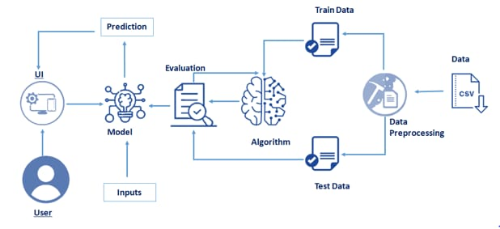
Technical Architecture :

Slide 7
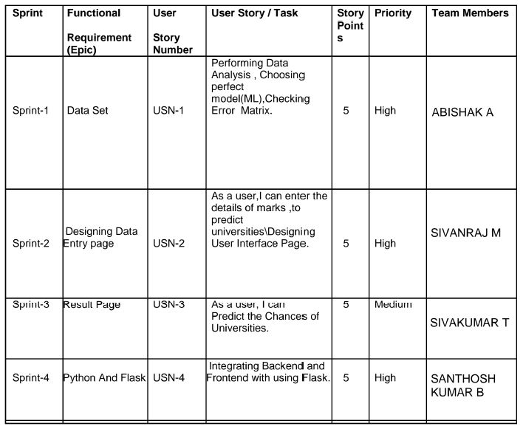
Sprint Planning
Empathize
Define
Ideate
Prototype
Test.

Slide 8
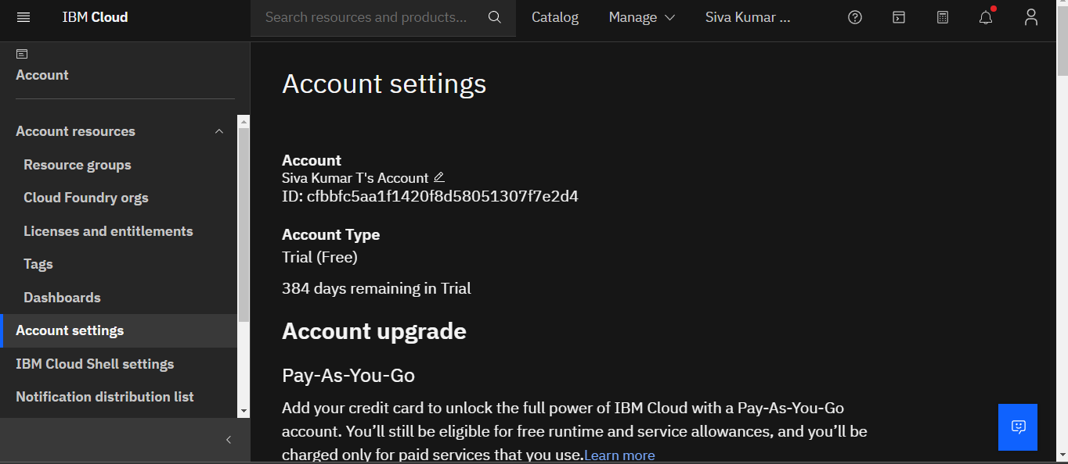
Train the model on IBM :

Slide 9
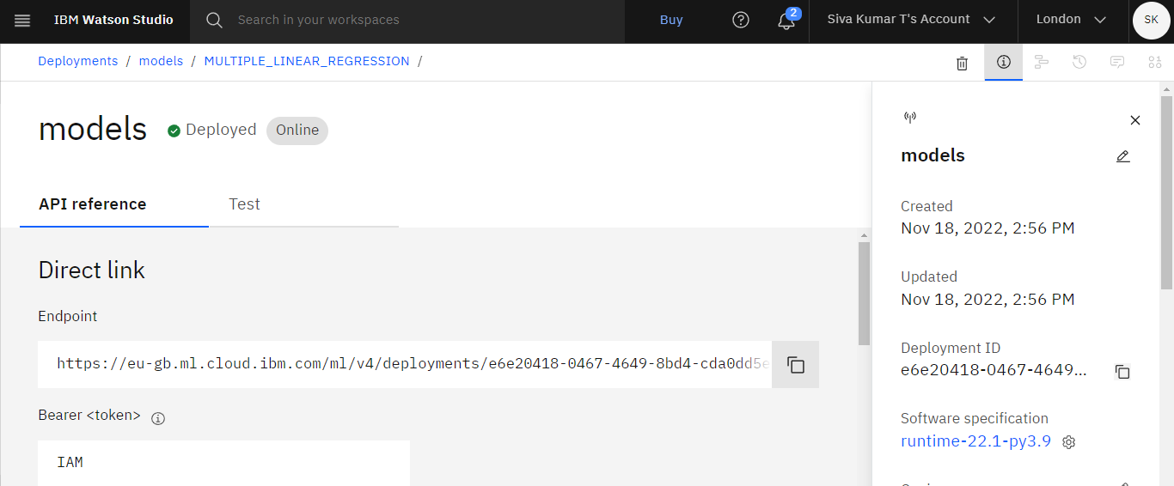
Create a deployment model using IBM Watson Studio

Slide 10
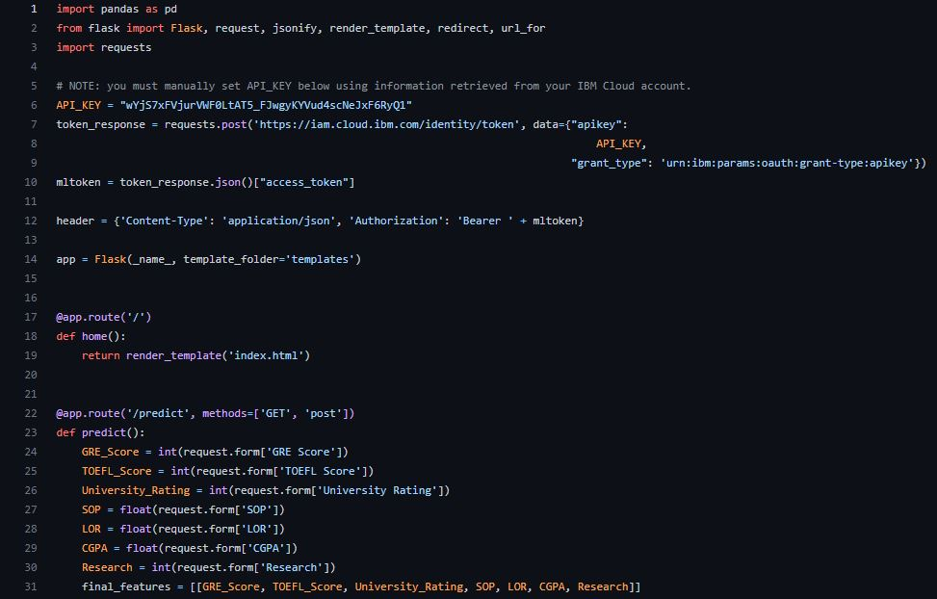
App.py

Slide 11
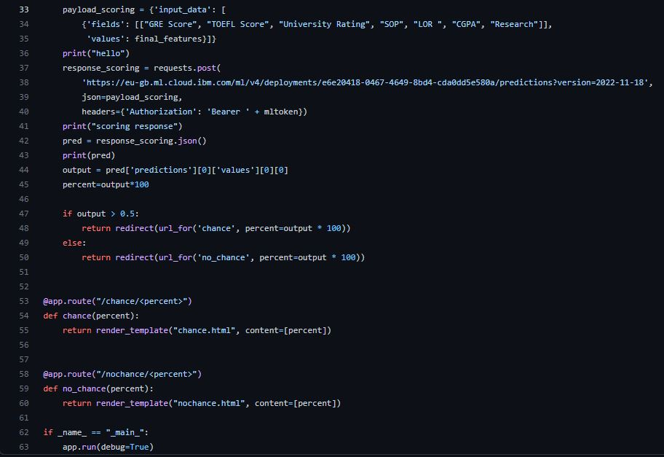
App.py

Slide 12
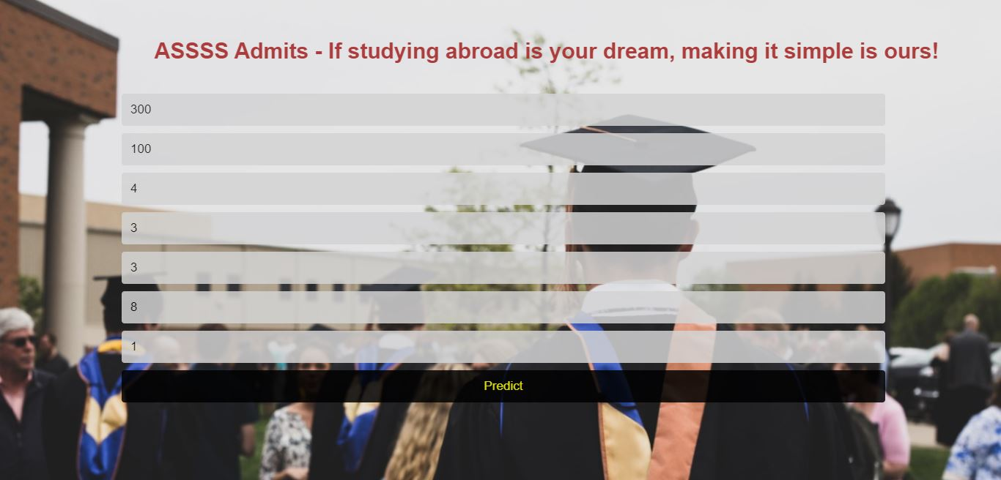
Test Cases :
Case 1- For eligible students

Slide 13
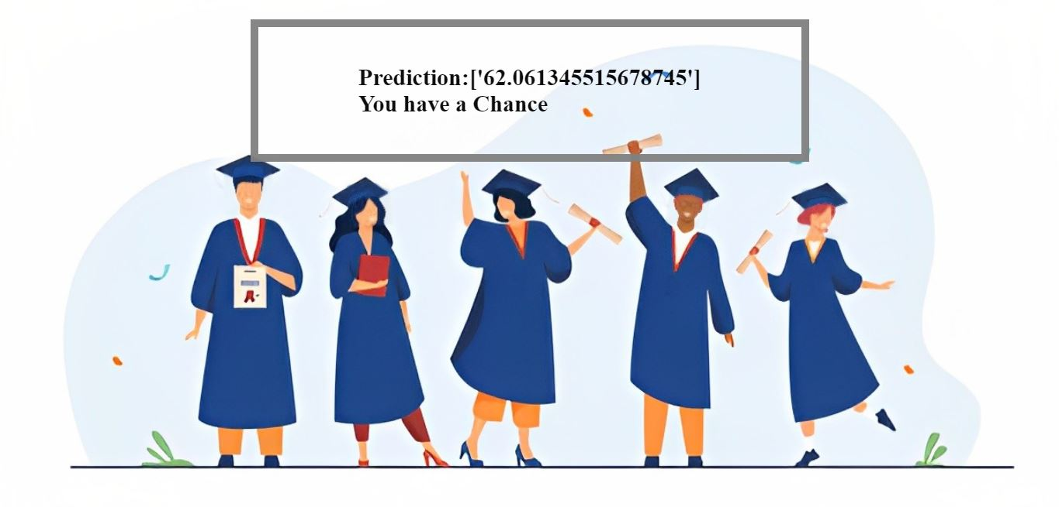
Test Cases :
Case 1- For eligible students

Slide 14

Test Cases :
Case 2- For not eligible students

Slide 15

Test Cases :
Case 2- For not eligible students

Slide 16

Advantages & Disadvantages

Slide 17

Conclusion :

Slide 18

Future scope :

Slide 19


